Slide 1
Case Study of Customer_retention
By Neha Sharma

Slide 2
Problem Statement
Customer satisfaction has emerged as one of the most important factors that guarantee the success of online store.
A comprehensive review of the literature, theories and models have been carried out to propose the models for customer activation and customer retention.
Here, we need to find the key features that helps to investigated the factors that influence the online customers repeat purchase intention.

Slide 3
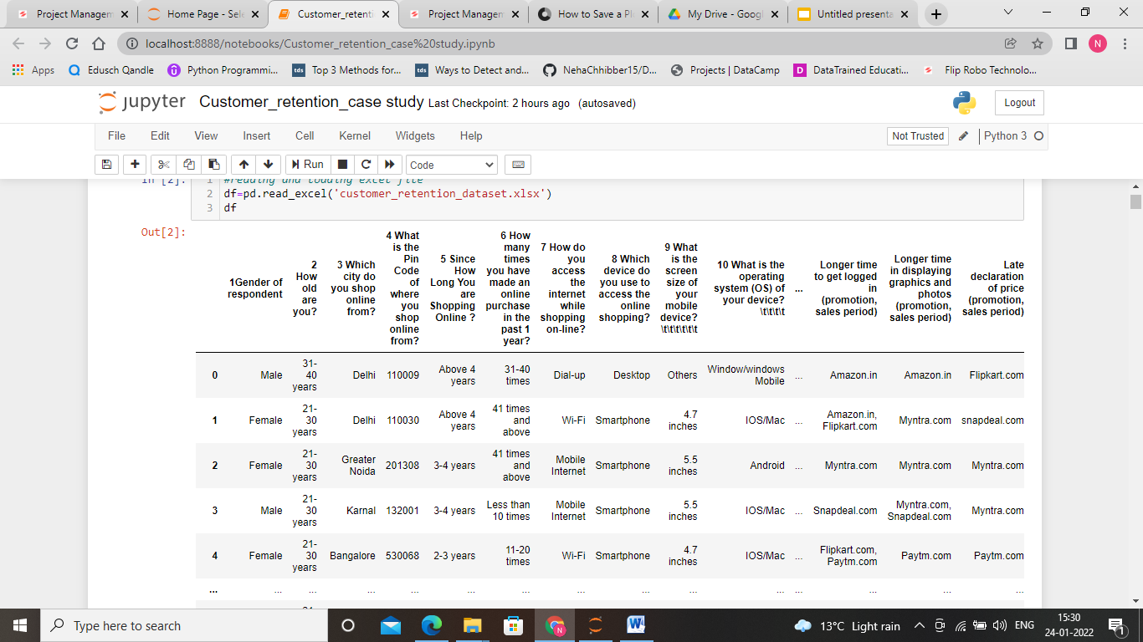
Introduction
In the given data set there are 269 rows and 71 columns.

Slide 4
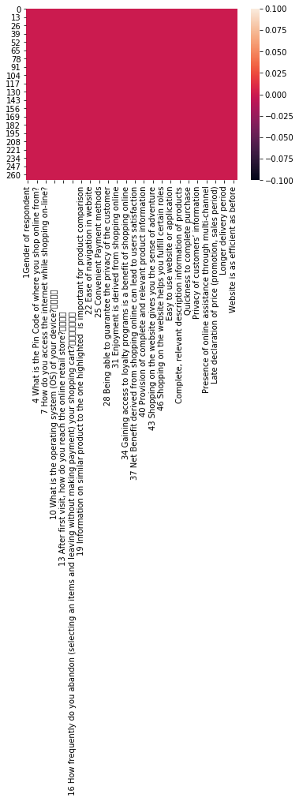
Exploratory Data Analysis
Step1: On observing the data set we can find that there are 71 features present in the given data set.
Step2: Next step is to identify is there any null values present in the given data set or not. Let us plot heatmap of the given dataset.

Slide 5
Here, we can see that there is no null value present in the given data set.
Step3: let us find the number of categorical and numerical columns present in the given data set.
We find that there are 70 categorical and 1 numerical columns present in the given dataset.

Slide 6
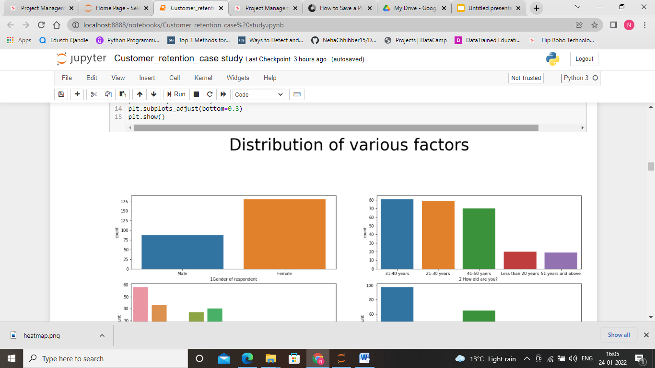
Univariate Analysis
Let us explore each feature present in the given data set by using different visualization tools.

Slide 7
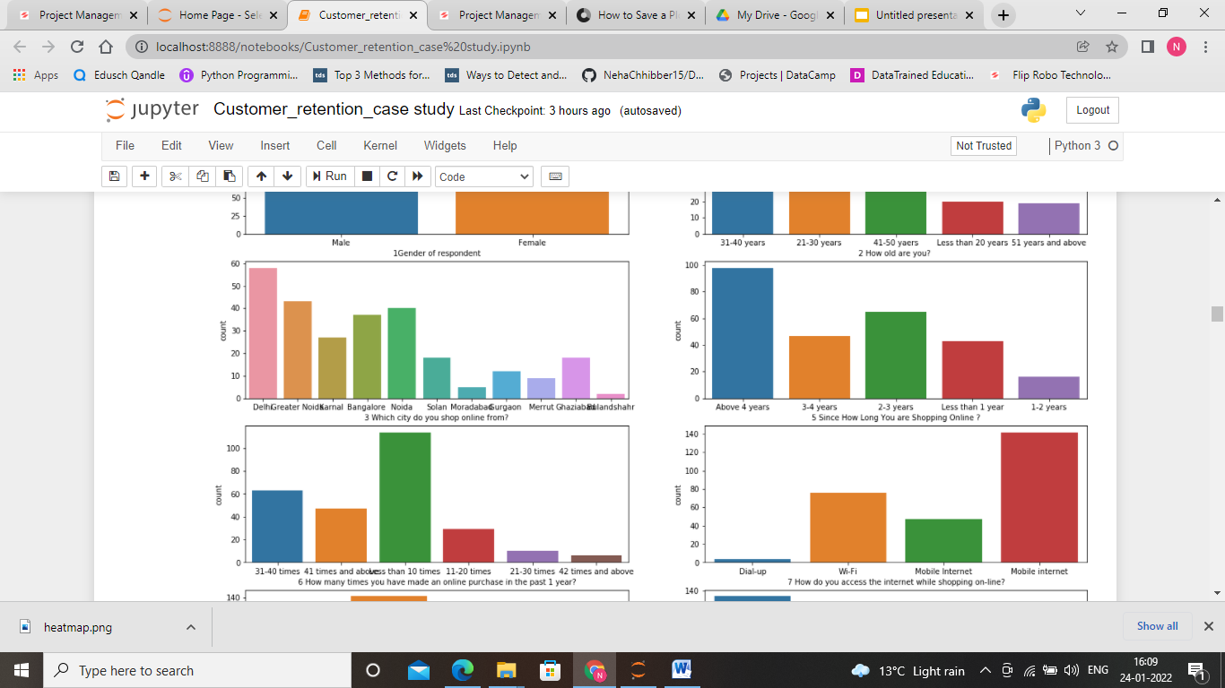

Slide 8
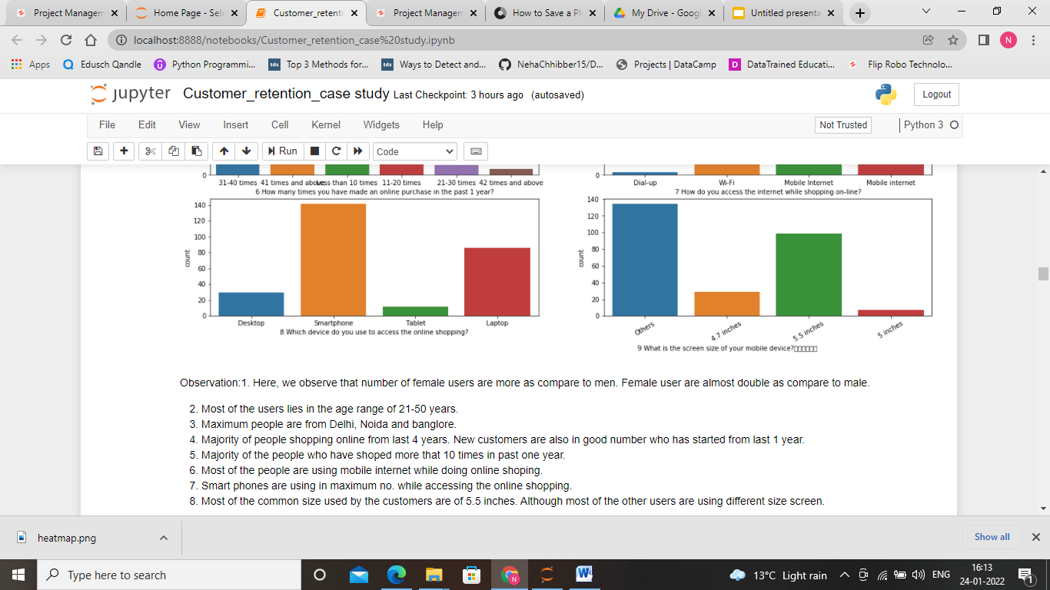

Slide 9
Observations
1. Here, we observe that number of female users are more as compare to men. Female user are almost double as compare to male.
2. Most of the users lies in the age range of 21-50 years.
3. Maximum people are from Delhi, Noida and banglore.
5. Majority of people shopping online from last 4 years. New customers are also in good number who has started from last 1 year.
6. Majority of the people who have shopped more that 10 times in past one year.
7. Most of the people are using mobile internet while doing online shopping.
8. Smart phones are using in maximum no. while accessing the online shopping.
9. Most of the common size used by the customers are of 5.5 inches. Although most of the other users are using different size screen.

Slide 10
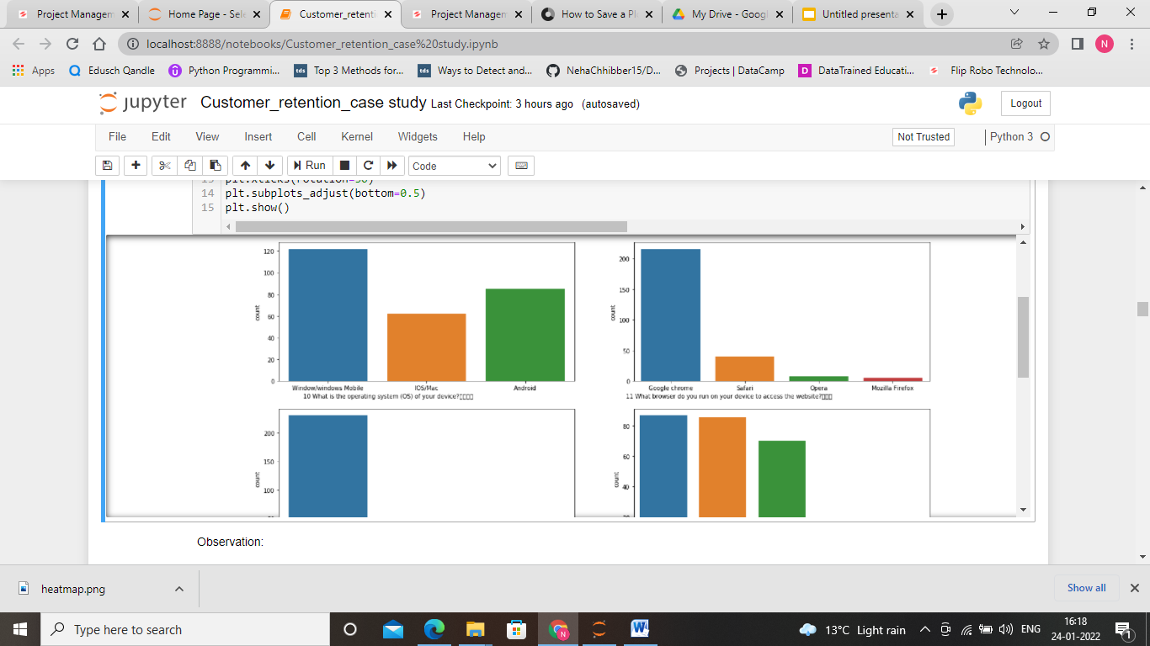
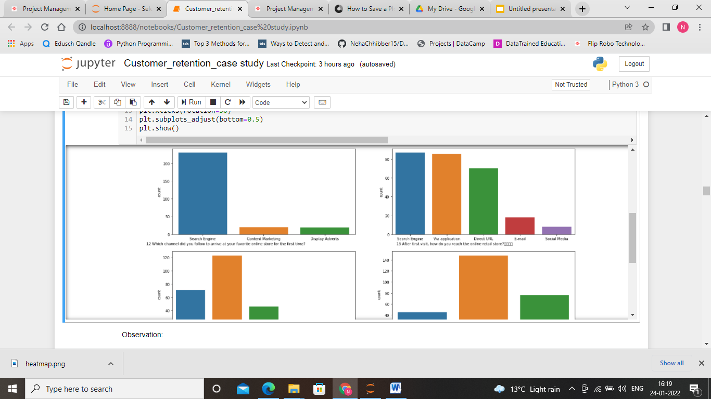

Slide 11
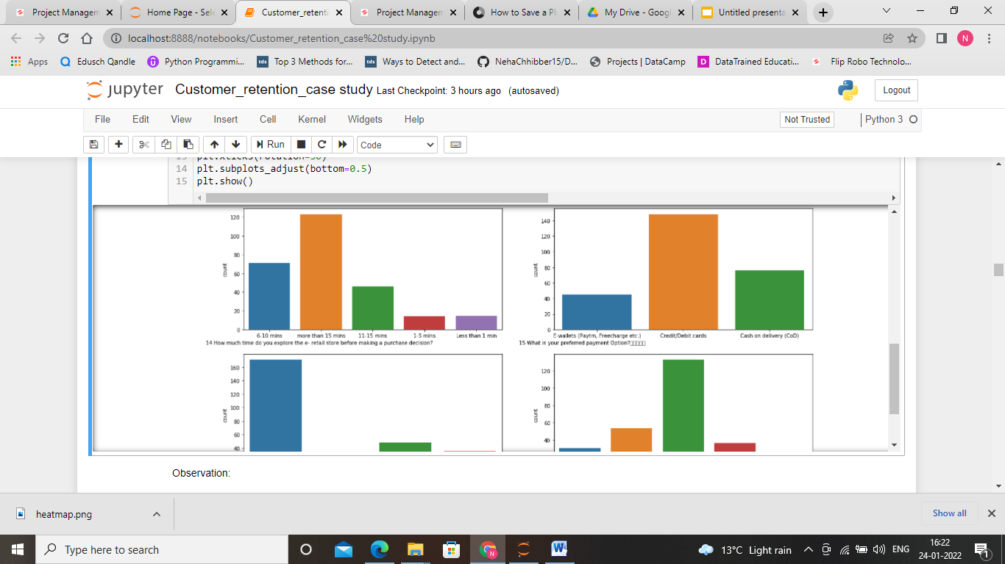
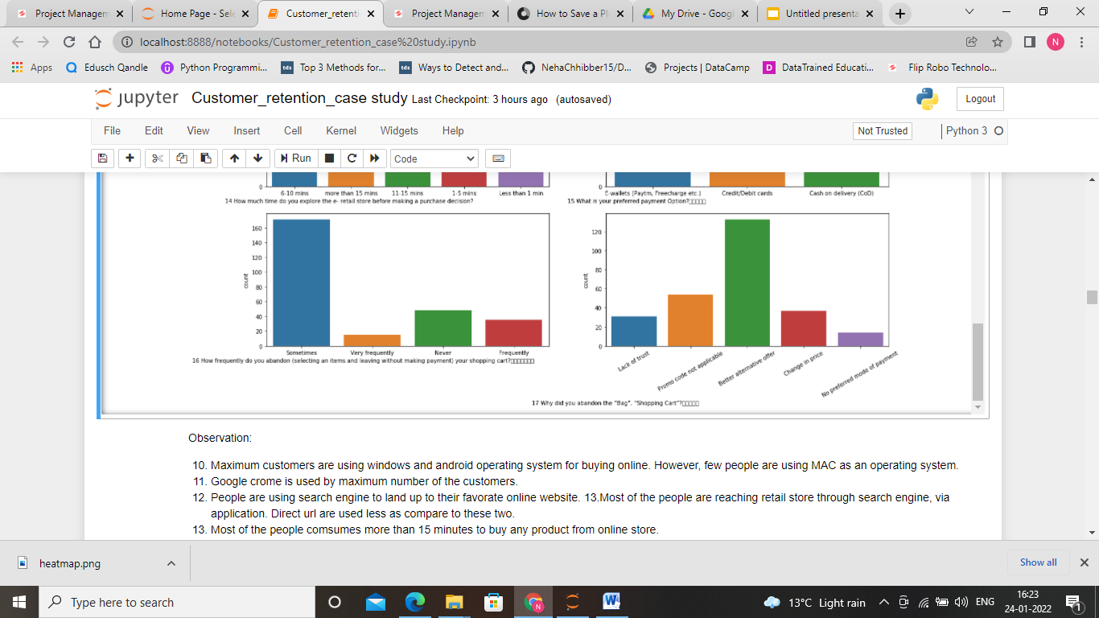

Slide 12
Observation
10. Maximum customers are using windows and android operating system for buying online. However, few people are using MAC as an operating system.
11. Google chrome is used by maximum number of the customers.
12. People are using search engine to land up to their favorite online website.
13.Most of the people are reaching retail store through search engine, via application. Direct url are used less as compare to these two.
14. Most of the people consumes more than 15 minutes to buy any product from online store.
15. People like credit/debit card to use the most to buy any product online.
16. Sometime cases are more when customer abandon item and leaving without payment.
17. Reason for abandon the cart most of the time they got better alternative offer.

Slide 13
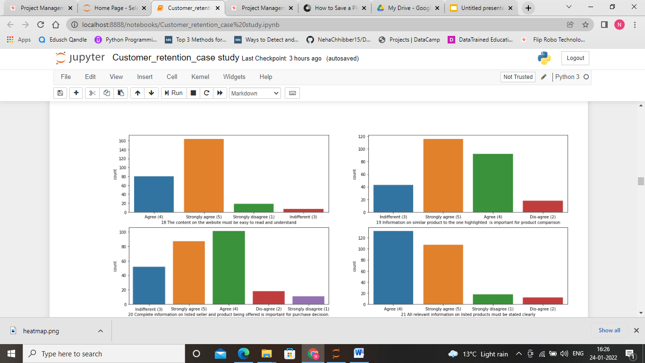

Slide 14
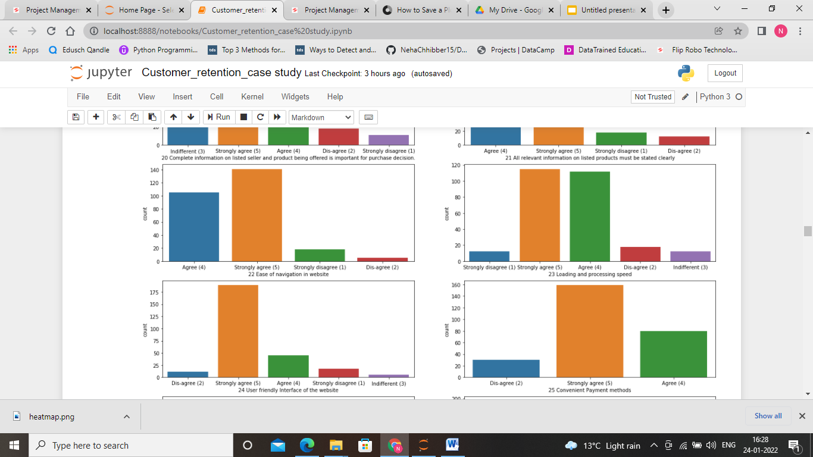
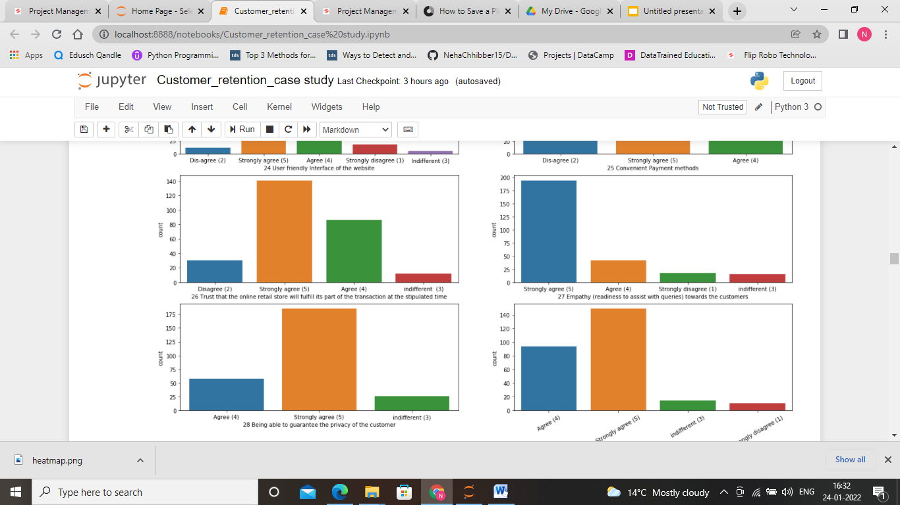

Slide 15
Observation
18. Most of the customers are agree that website must be easy to understand.
19. Most of the customers strongly agree that Information on similar product to the one highlighted is important for product comparison
20. Most of the customers agree that complete information on listed seller and product being offered is important for purchase decision.
21. Most of the customers agreed that all relevant information on listed products must be stated clearly.
22. Most of the customers are agreed that they can easily navigate the website.
23. Most of the customers are agreed on the loading and processing speed is good.
24. Most of the customers agreed that interface of website should be user friendly.
25. Most of the customers agreed that website should have convinent payment method.
26. Most of the customers trust that the online retail store will fulfill its part of the transaction at the stipulated time.
27. Most of the customers agreed on website should have empathy (readiness to assist with queries) towards the customers.
28. Most of the customers agreed on being able to guarantee the privacy of the customer.
29. Most of the customers agreed on website should be responsible, availabile of several communication channels (email, online rep, twitter, phone etc

Slide 16
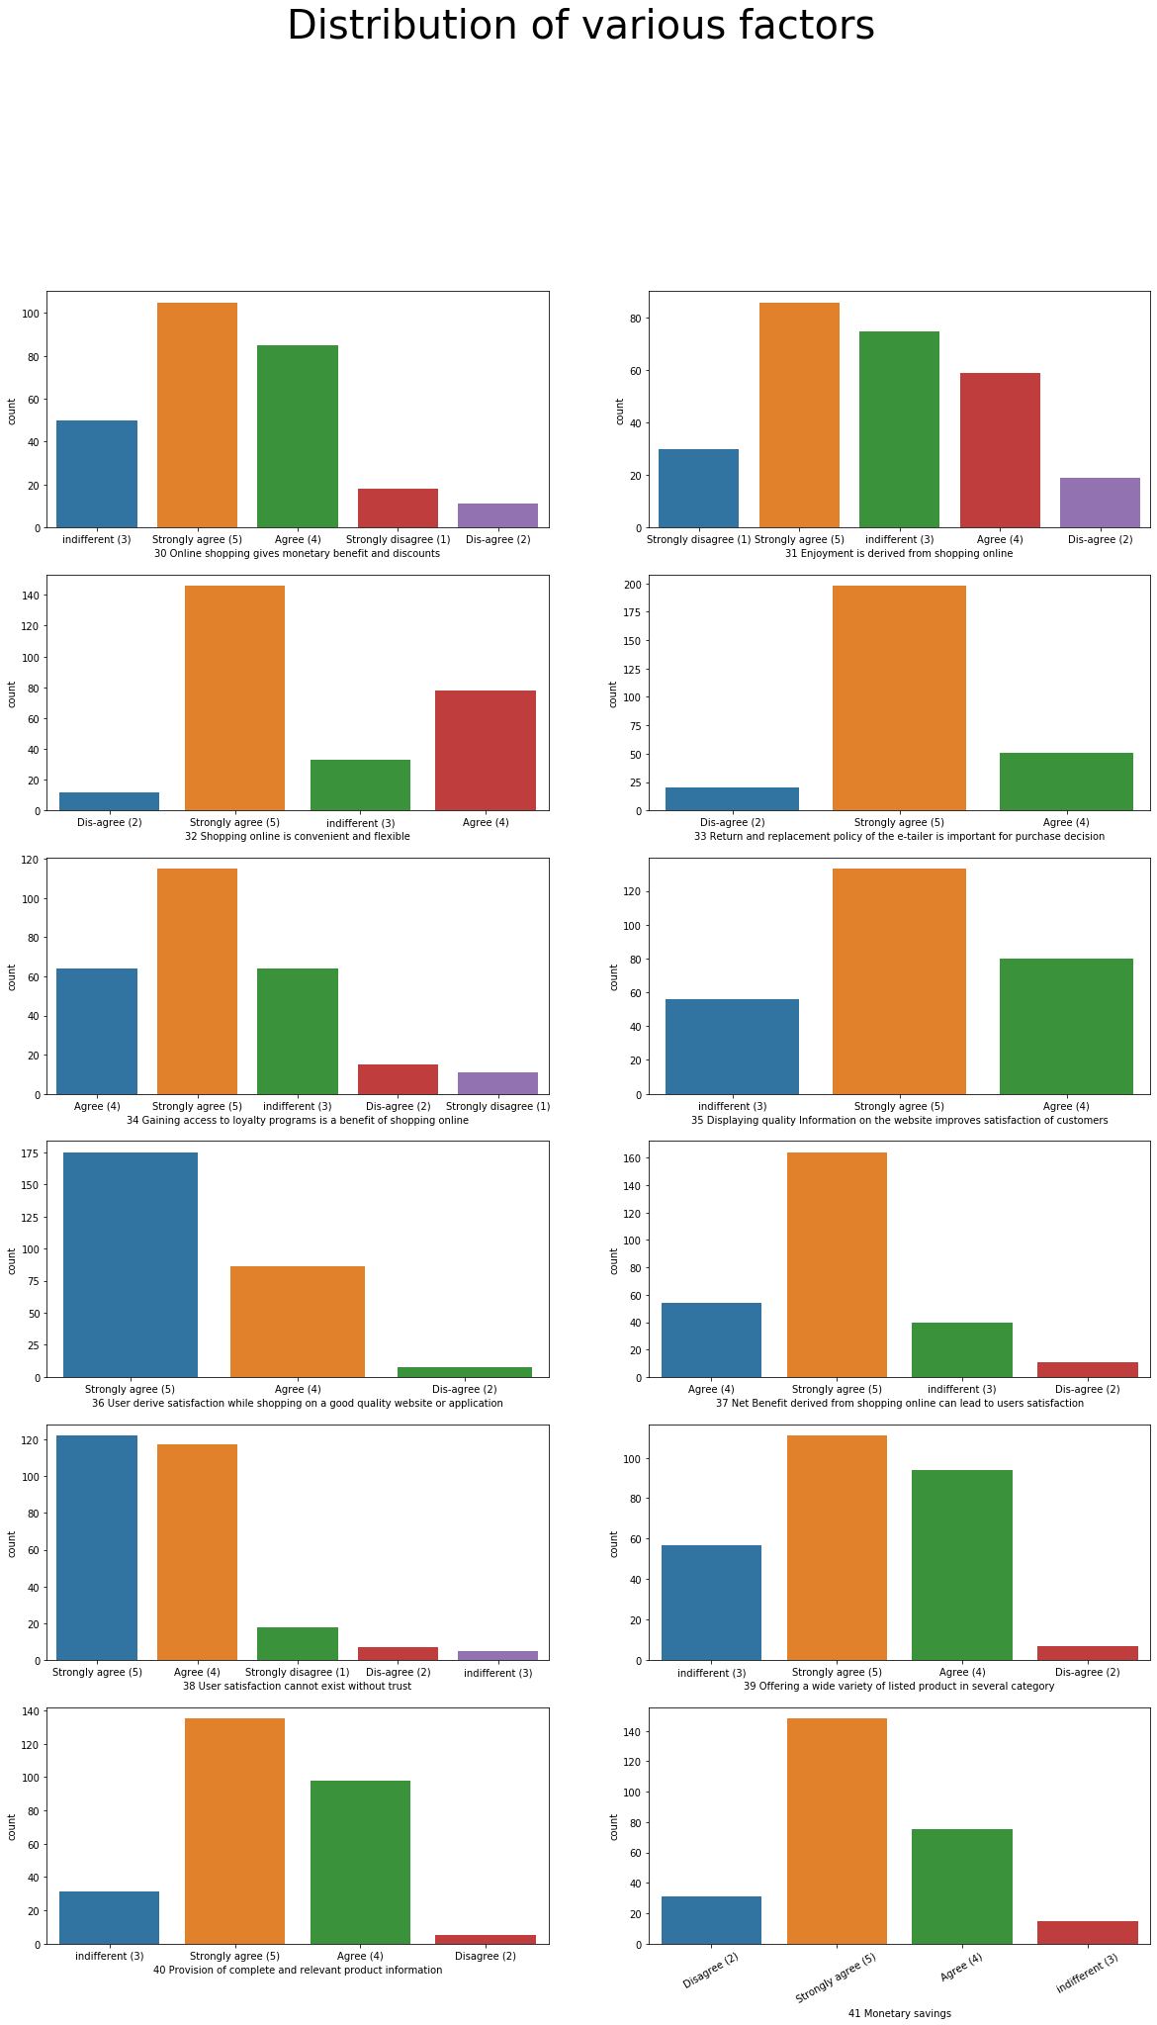

Slide 18
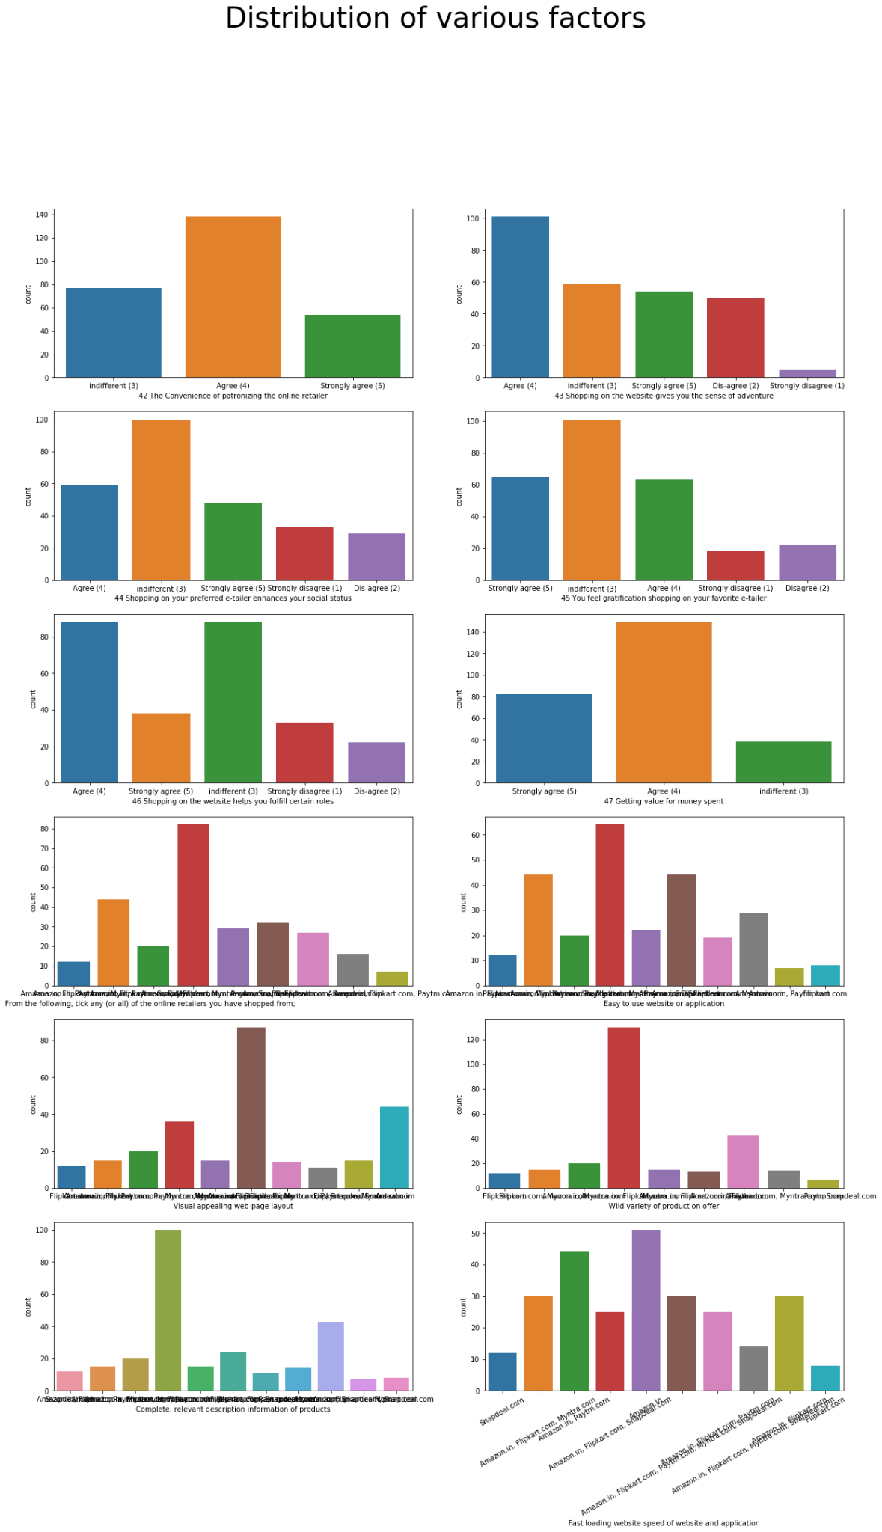

Slide 20
Observation
Most of the customers are agreed on the given statements about website:
The Convenience of patronizing the online retailer
Shopping on the website gives you the sense of adventure
Shopping on your preferred e-tailer enhances your social status
You feel gratification shopping on your favorite e-tailer
Shopping on the website helps you fulfill certain roles
Getting value for money spent
Most of the customers have shoped from amazon, ptm, myntra.
Amazon has good loading speed.

Slide 21
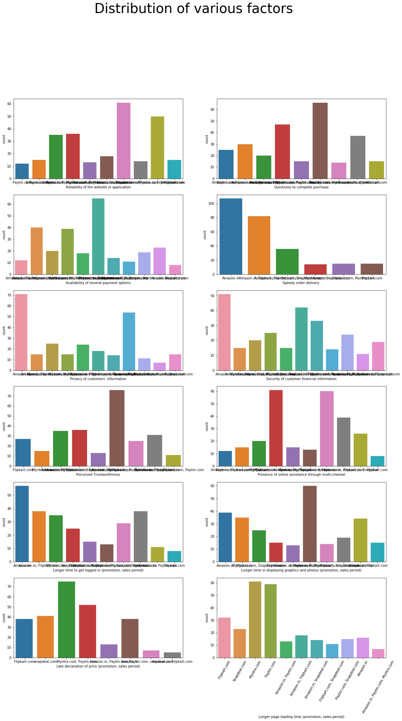

Slide 22
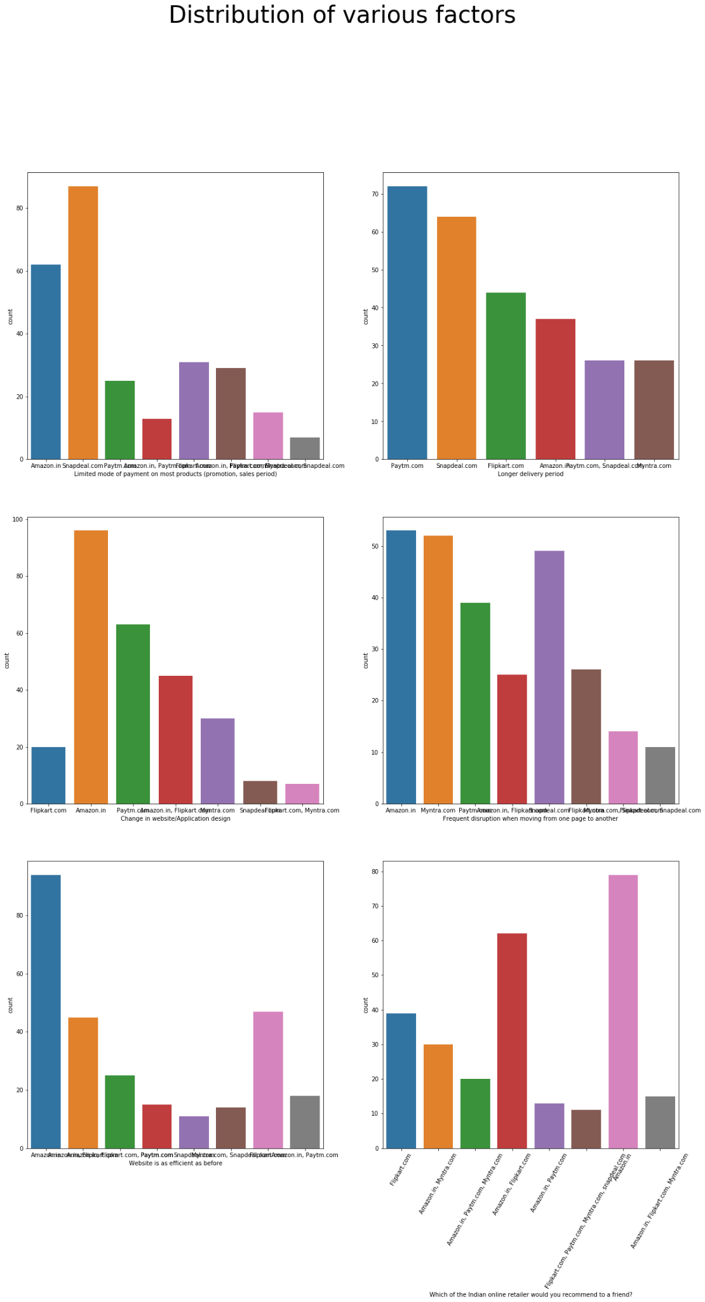

Slide 23
Observation
1. Amazon, snapdeal has maximum limited mode of payment
2. ptm,snapdeal has longer delivery period as compare to other website.
3. In amazon there are maximum changes in the website design as compare to other website.
4. Amazon, flipkart has very much efficient website as compare to other websites.
5. People are referring maximum amazon, flipkart, myntra as compare to others.

Slide 24
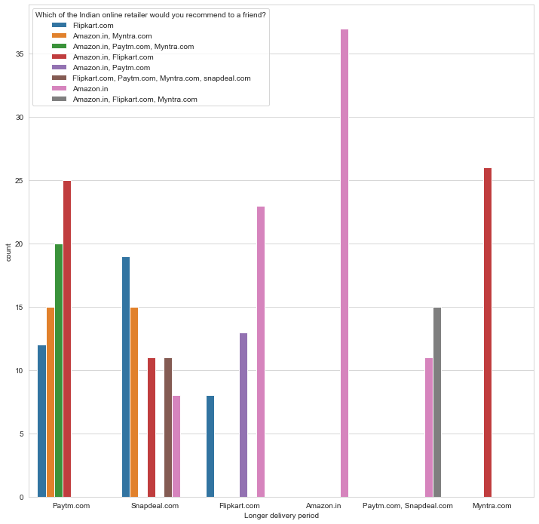
Bivariate Analysis

Slide 25
Observation
Here, we can see that Amazon, flipkart and Myntra is mostly recommended by the people due to shorter delivery period.

Slide 26
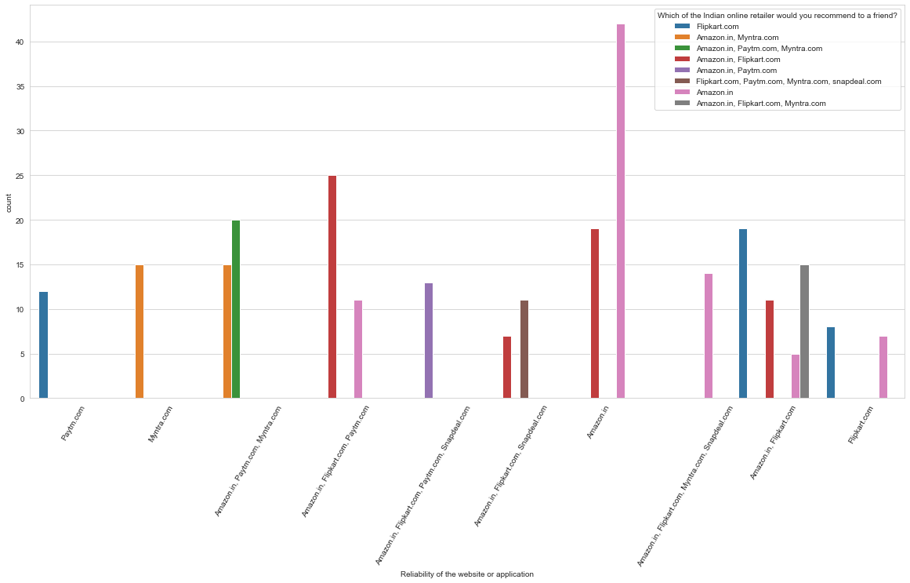

Slide 27
Observation
Here, we can see that Amazon, flipkart and Myntra is mostly recommended by the people due to shorter delivery period.

Slide 28
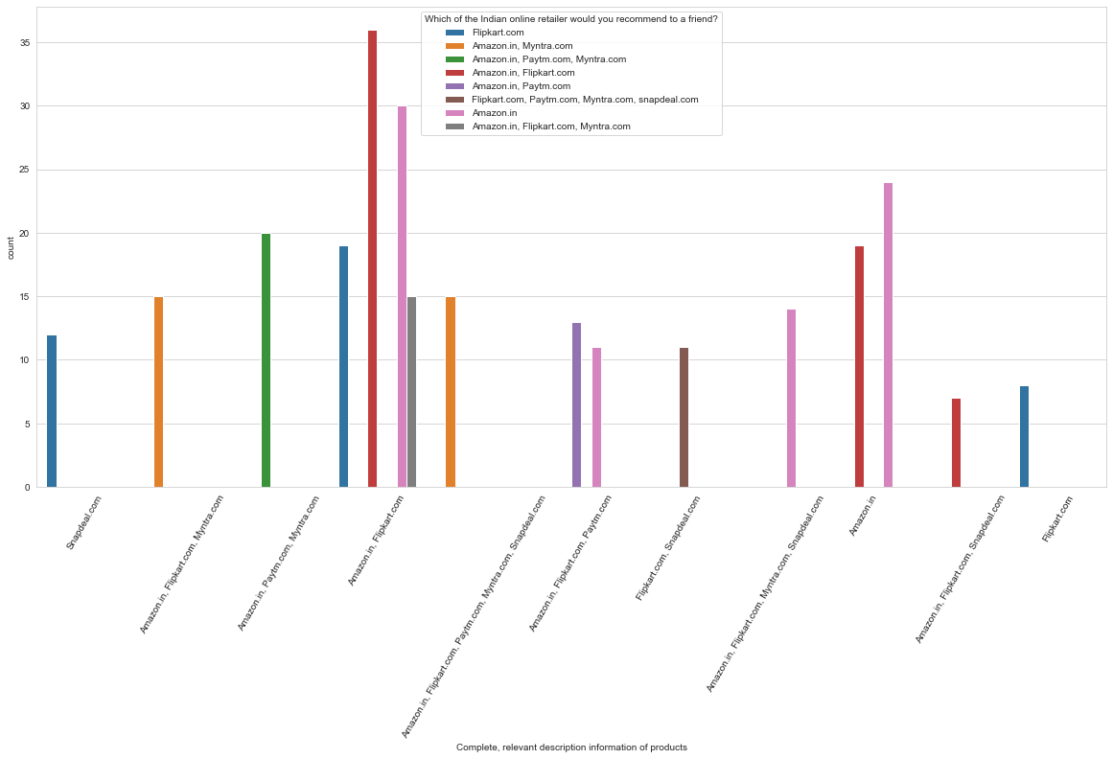

Slide 29
Observation
Here, we can see that people are recommending Amazon and flipkart the most because they believe that they are providing complete, relevant description information of product.

Slide 30
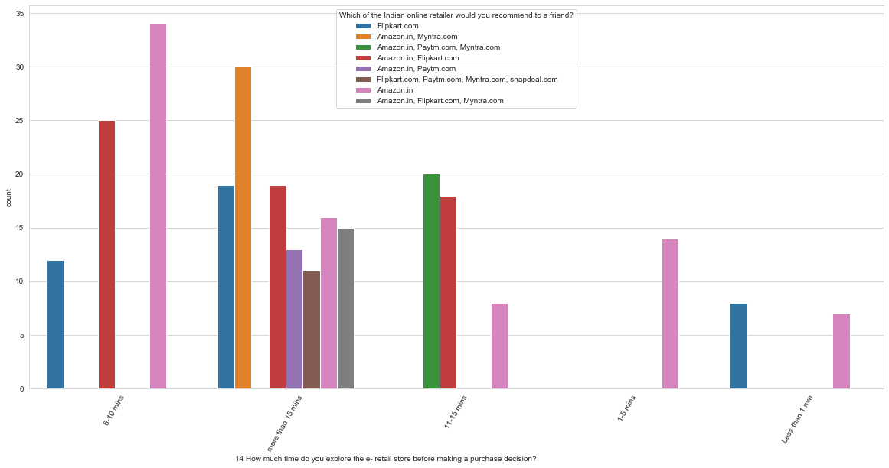

Slide 31
Observation
Here we can see that people spending more time on website recommend the most.

Slide 32
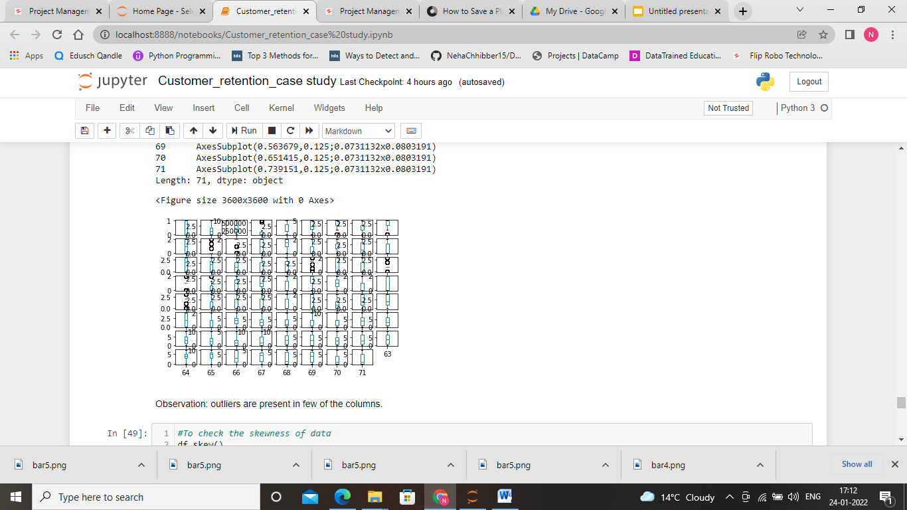
Outlier Detection
Here, we can see that there are outliers present in the given data set which makes the data imbalance.

Slide 33
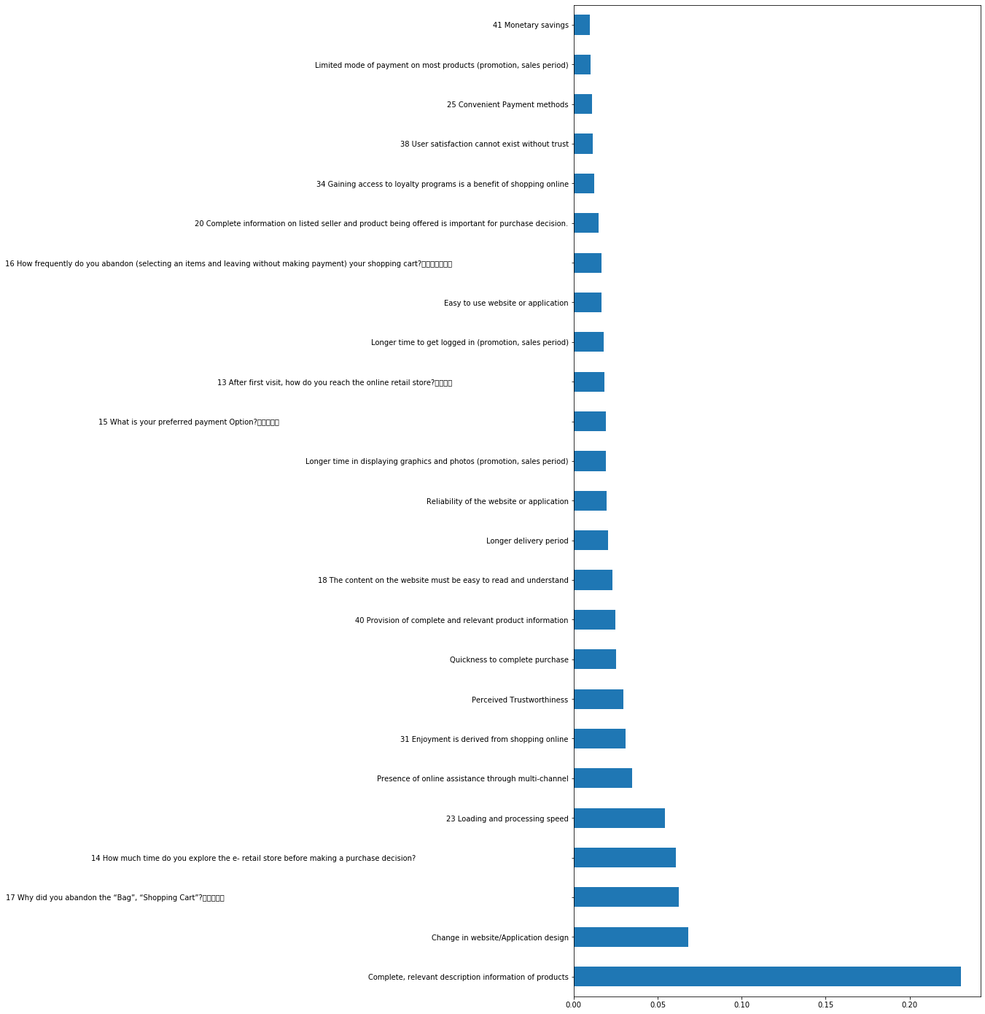
Feature selection

Slide 34
Observation: The top 25 features that impact the customer to retain the services and recommend it to their friends.
1. 'Complete, relevant description information of products'
2. 'Change in website/Application design'
3. '17 Why did you abandon the “Bag”, “Shopping Cart”?\t\t\t\t\t 4. '14 How much time do you explore the e- retail store before making a purchase decision? 5. '23 Loading and processing speed' 6. 'Presence of online assistance through multi-channel'
7. '31 Enjoyment is derived from shopping online'
8. 'Perceived Trustworthiness'
9. 'Quickness to complete purchase'
10. '40 Provision of complete and relevant product information'
11. '18 The content on the website must be easy to read and understand'
12. 'Longer delivery period'
13. 'Reliability of the website or application'
14. 'Longer time in displaying graphics and photos (promotion, sales period)'
15. '15 What is your preferred payment Option?\t\t\t\t\t '
16. '13 After first visit, how do you reach the online retail store?\t\t\t\t
' 17. 'Longer time to get logged in (promotion, sales period)'
18. 'Easy to use website or application'
19. '16 How frequently do you abandon (selecting an items and leaving without making payment) your shopping cart?\t\t\t\t\t\t\t '
20. '20 Complete information on listed seller and product being offered is important for purchase decision.'
21. '34 Gaining access to loyalty programs is a benefit of shopping online'
22. '38 User satisfaction cannot exist without trust'
23. '25 Convenient Payment methods'
24. 'Limited mode of payment on most products (promotion, sales period)'
25. '41 Monetary savings'

Slide 35
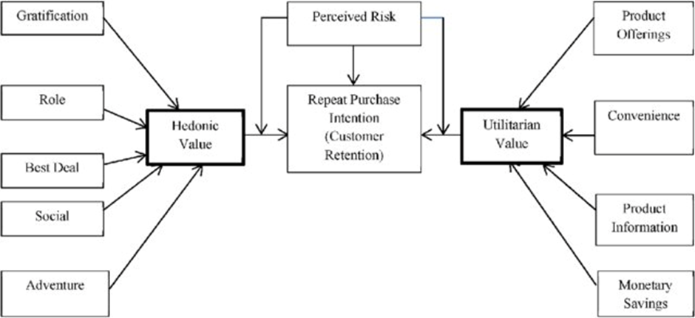
Analysis
On observing all the features of the data set we analyse that recommendation of a particular website or retention of a customer depend upon various Values such as hedonic values and utilitarian values.

Slide 36
In utilitarian value there are multiple factors that affect the customer to build their mind to repurchase the things are
Product offering: Most of the time customers are looking for lucrative offers, discounts, coupons, cashbacks etc. These are the factors that motivate the users to repurchase the products again.
Convenience: This is the another factors that make the customers to make a repurchase. Website providing good services such as easy replace, refund, easy to understand, easy to book, return motivates the customers in building their mind for repurchase.
Product information: It is most important point for a service provider to build a trust of a customers by providing complete information about the product, making their information or data secured, etc.
Monetary Saving: When we are buying a things there is a profit and loss statement in our mind. If a customer gets a saving on their purchase then its pretty obvious that he/she will become a loyal customer.

Slide 37
Hedonic Values
There are some hedonic values that influence the customers to make a repurchase are
Gratification: If a customer is satisfied with the services and product then it will influence the customer to make a repurchase.
Best Deal: Once a customer will get a best deal then it will build an impression on a customer that definitely he/she will get the best deal again. This helps in retention of a customer.
Social: References matter allot. Its more important to build new customers then retaining old ones.. If a customers feel that the services and products are good then he/she will recommend it in their social platforms such as facebook, intagram,..personaly to their friends.
Adventure: Sometimes customers wants to explore something else. In that case most of the time retention occurs.

Slide 38
Conclusion
On visualizing different bar graphs, we get to know that amazon and flipkart are the website which satisfies the maximum parameters such as product offerings, convenience, product information, trust factors, monetary benefits, gratification, deals, social etc. This makes these website more popular among the people. Myntra is sharing third position among the people to buy any product. Amazon is most popular website among the people due to their services and meeting the satisfaction level of the people.

